Slide 1
Personal Statement
Lesson version

Slide 2
Writing your Personal Statement
The Personal Statement is a key part of any application to UK Universities and is your opportunity to demonstrate that you would be an excellent student for the courses you are applying to.
It is primarily an academic statement and you must target it towards the subject in which you are interested!

Slide 3
Writing your Personal Statement
A great Personal Statement should cover the following three sections:
Why do you want to study this subject?
What have you done in the past that makes you particularly suitable to study the subject?
What else have you done that would contribute to the university community?
It may seem difficult but Unifrog’s Personal Statement tool can help you structure and prepare your Personal Statement!

Slide 4
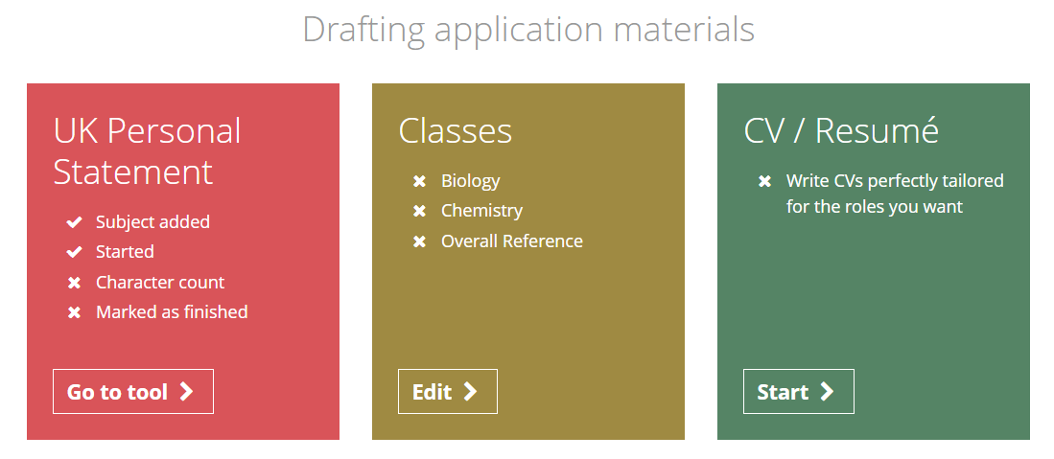
How to use the Personal Statement tool
From your student homepage, click on the UK Personal Statement tool under the ‘Drafting application materials’ subheading

Slide 5
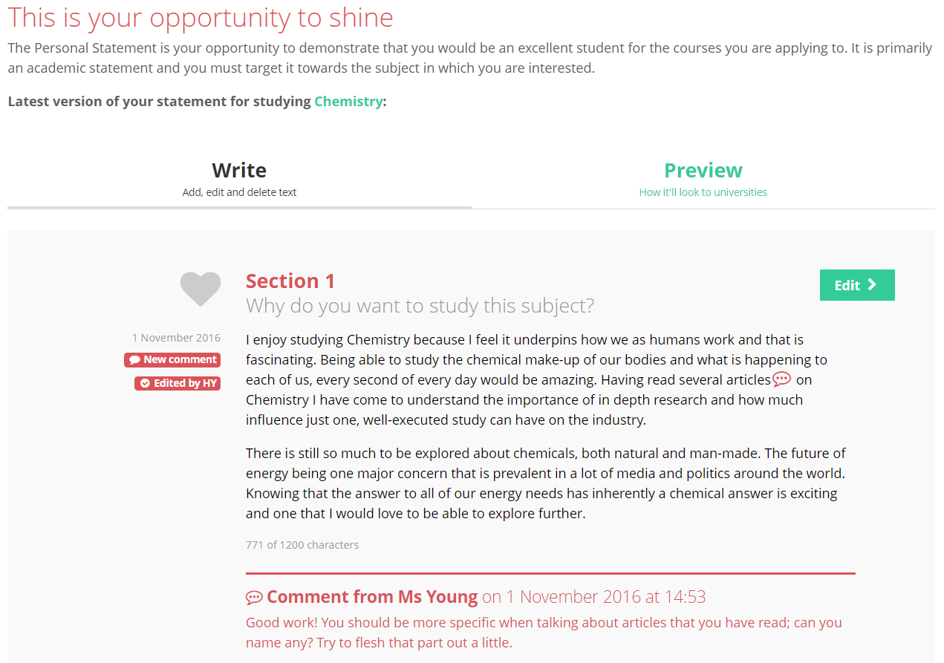
How to use the Personal Statement tool
At the top, you can see the university subject of which you are writing the Statement for. This can be edited anytime by simply clicking on the green text.

Slide 6
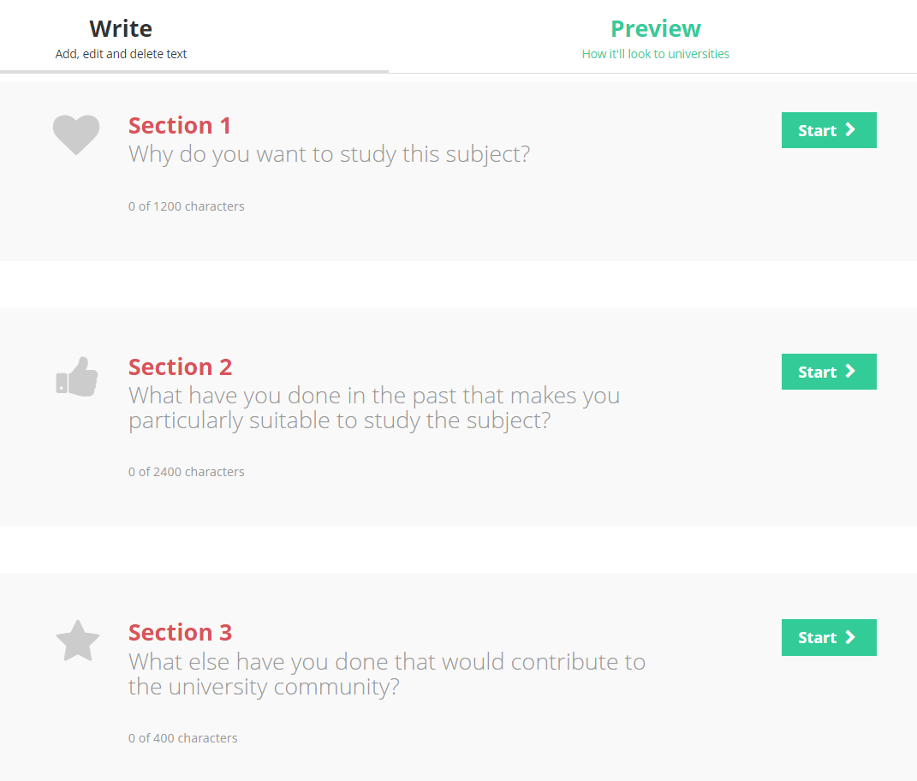
How to use the Personal Statement tool
The tool splits your Personal Statement into three sections. You can complete these in any order and come back to each section as many times as you like.
Click on ‘Preview’ to see how your personal statement will look as one section.

Slide 7
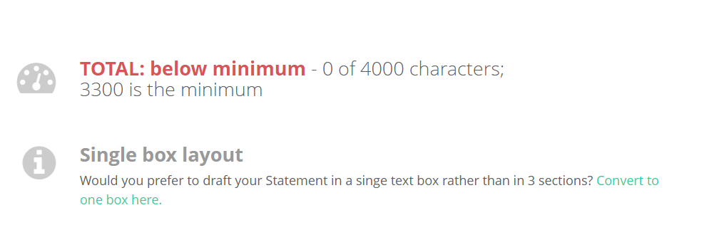
How to use the Personal Statement tool
You can also choose to write the Personal Statement in 1 box rather than 3.
To do this, scroll down to the bottom of the page and click on ‘Convert to one box here.’

Slide 8
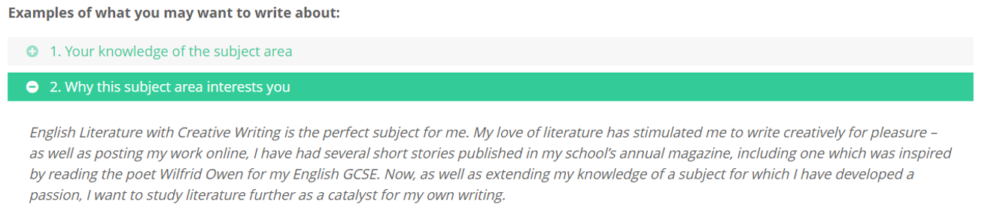
How to use the Personal Statement tool
At the top of each section you will see some prompts in green text. Each one expands to show an example.
Remember that your Personal Statement needs to be personal to you so do not use these templates word for word; use them as guidance and inspiration!

Slide 9
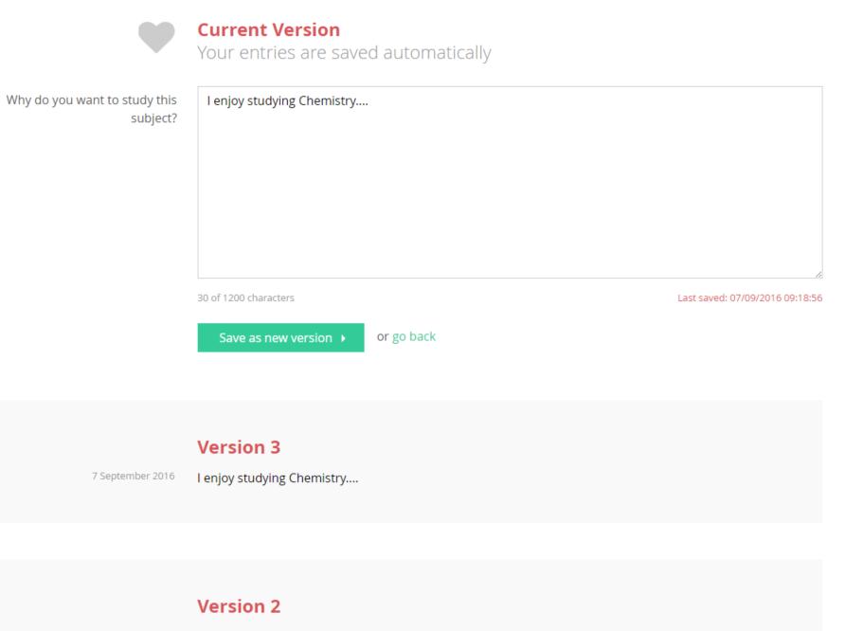
How to use the Personal Statement tool
Whatever you type will be automatically saved within this box until you’re ready to save it as a new version.
You can save as many versions as you like. Your version history will be shown below your current version.

Slide 10
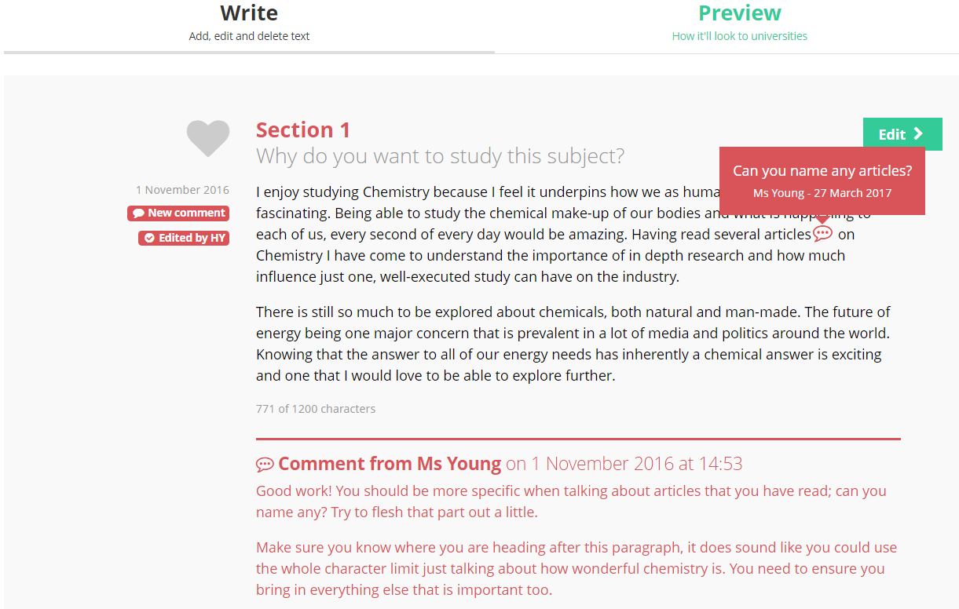
How to use the Personal Statement tool
On the Personal Statement homepage you can see if a teacher has written any comments within your text or left feedback at the bottom.

Slide 11
How to use the Personal Statement tool
Hover over the speech bubble in the text to see the comment.
These comments and notes stay with that particular version of your Personal Statement.

Slide 12
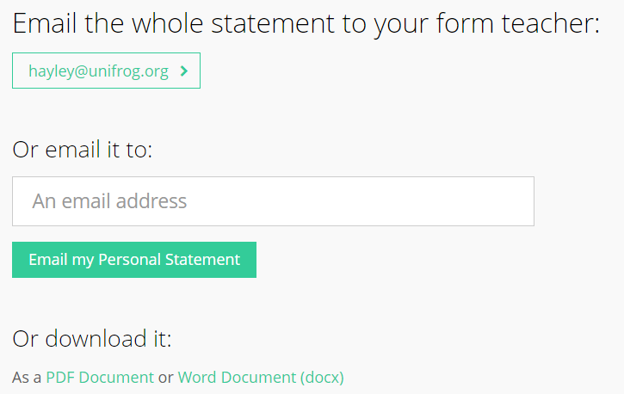
How to use the Personal Statement tool
Scroll to the bottom to see the character count and whether or not a teacher has marked it as finished.
You can send the latest draft of your full Personal Statement to anyone by using this function at the bottom of the page. You can download it here too.

Slide 13
Next steps
Go and explore the tool further and start thinking about the three parts of the Personal Statement.
Read the Know-how library guide ‘Writing like a boss: the Personal Statement’ to help you prepare for writing your Personal Statement.
Extra reading:
Go back to the Know-how library and search for ‘Personal Statements’. There are many example Personal Statements with breakdowns of why students wrote what they did! Favourite guides to refer back to later.
Notes:
Teachers’ notes: Class discussion – These tasks can be done during the session if you have time, or set as homework. You can easily track the progress students have made on their Personal Statements on Unifrog.
To see students’ progress, login to Unifrog, go to Advanced > Select the year group > Sort by > Personal Statements

