Slide 1
Year 11 – A Level business Taster Session

Slide 2
Introduction to Course

Slide 3


Year 1 - What you will learn?
Theme 1
  Meeting Customer Needs
  The Market
  Marketing Mix and Strategy
  Managing People
  Entrepreneurs and Leaders
Theme 2
  Raising Finance
  Financial Planning
  Managing Finance
  Resource Management
  External Influences

Slide 4

Year 2 - What you will learn?
Theme 3
  Business Objectives and Strategy
  Business Growth
  Decision-making Techniques
  Influences on Business Decisions
  Assessing Competitiveness
  Managing Change
Theme 4
  Globalisation
  Global Markets and Business Expansion
  Global Marketing
  Global Industries and Companies

Slide 5
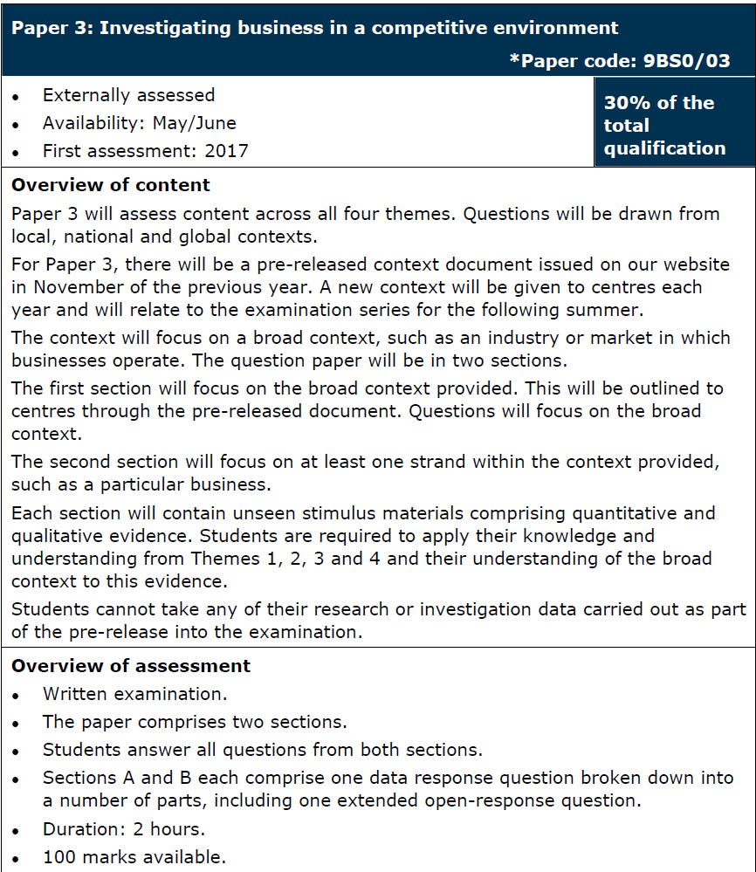
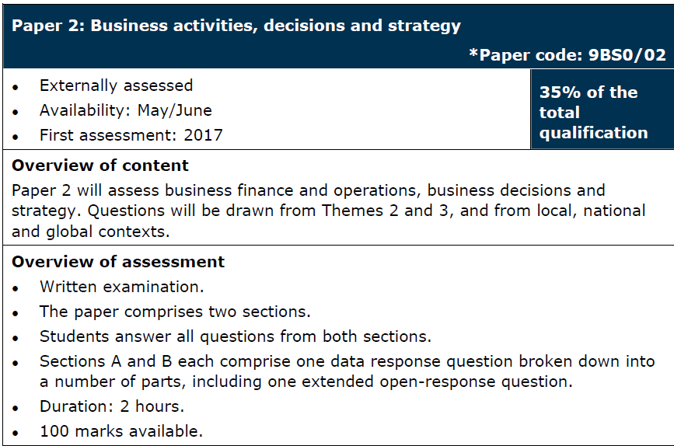
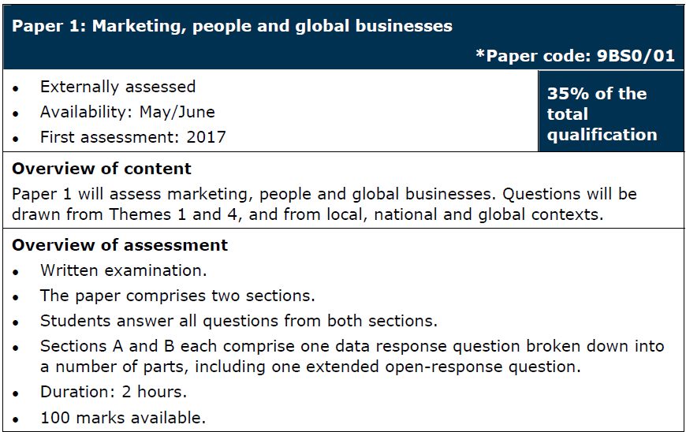
A2 Level - Exams

Slide 6

Typical Lessons
Your lessons will include:
Detailed PowerPoint presentations
Case studies where theory is applied to real businesses
Textbook questions and data responses
Past paper questions
Independent research
Student presentations

Slide 7

Expectations of you
Homework – this is set weekly and is the best way for you to monitor your understanding of the theories and exam technique
Participation in lessons
Extra reading in your own time- you are expected to have an awareness of the current business environment
Attendance and punctuality!!

Slide 8
Today’s Task – trends in the fast food/takeaway/restaurant industry

Slide 9

Paper 3 Exam
Your A-Level Paper 3 exam is always based on a pre-released case study, the exam board will provide an industry that you are required to conduct some research into
All questions on Paper 3 will be about this industry – fast food/takeaway/restaurant
Students are required to undertake their own research – you must remember key points and bring them into your exam answers as context

Slide 10
The 2021 Context

Slide 11

Your task
Using the worksheet provided – complete the research task on the fast food/takeaway/restaurant industry
Find some key information and note it down
Then read the case study and answer the questions attached

