Slide 1
AQA A Level English Language
A ‘taster’ introduction to A Level Language
(It’s NOT the same as GCSE… and
it’s NOT to improve your English skills)

Slide 2
How Does Language work Between People?
The dynamic of language
Watch and decide what is NOT working about this conversation…!

Slide 3
How Does Language work Between People?
The dynamic of language
You will study this at the levels of the individual, society – its cultures and its institutions eg. occupation, the media, government,
Initially sensitive and considerate: conveyed through his ‘gentle’ prompting and tone of voice, which are meant to accommodate her needs. He ‘reads’ this exchange as a delicate but necessary exchange of factual information enabling the appearance of the perpetrator to be conveyed accurately.
The comic effect of the scene is created by the victim’s inability to communicate in the appropriate way for his needs: her language choices are highly metaphorical and ambiguous, and stubbornly divergent from what is required in the context of law. The comic conclusion to this discourse is the policeman’s increasingly obvious irritation – to the extent that he ‘breaks’ the unspoken code of politeness and sensitivity that governs this type of interaction, and the power roles are reversed – he becomes the victim.
The language choices, the power roles, the influence of gender, and the pragmatics of this discourse are the stuff of A level language study
You may have identified examples of the above language behaviours.

Slide 4
Language is always in the news! Language headlines of 2020
Language change and playfulness/creativity around language use
Language and ‘political correctness’
Language and stereotypes of intelligence or class
What sorts of issues around language use can you see here?
Notes:
A glimpse of language in the headlines over 2020! Are you interested in the power of language? Would you be interested in looking at how language can make and break careers? How it can be used to lead to arrests and incarceration? How language evolves to describe and define new elements of our lives? Would you like to explore accent prejudice in people’s professional and personal worlds? Do you want to know more about political correctness and how language can cause offense and break and create new laws? If so, English Language is definitely a course for you!

Slide 5
Learning how to analyse language
How do I look?
Pragmatics
A new terminology….
Like you’re ready to take on the world!L
Intended meaning and purpose; unintended impact
Lexis and
Semantics
….and you’ll need to be
Layout, visual mapping
Graphology
Discourse
Like an accident in the blender mate….
Genre, format, organisation of whole text
Vocabulary, choices of words and ideas
Phonology
Grammar
Sounds and sound effects
Parts of speech, sentence structure
Notes:
Like GCSE – specialised toolkit is used for identifying and describing features of language – lets remind ourselves of that idea that what we think and what we say is not always as attuned as we think – or want it to be! Students indeed are in daily conflict – perhaps more so before lockdown – with this very issue.
Cogs: So – just so you know… and you probably know more than you think: A level teachers will be the first to say that they got there before the GCSE! –Increasingly terminology is being appropriated by the official almanac – semantic field, lexis… register, discourse not far off. And wouldn’t pragmatics be a useful word for soooo much that we look at at GCSE: the meaning behind the message!
What follows is a funny video clip from Big Train – inappropriacy of language and context; the official what do students need to study at A level if you succeed in this mission and one of them actually asks you about it, and what good partner subjects, and ‘beyond’ destinations might look like – for in your own time and need! Thank you!

Slide 6
What will you study? An overview
Sociolinguistics
Representations
Language Diversity
Gender
Identity
Ethnicity
Age
Occupation
Region
Social networks
Social class
Children’s Language Development
Language Change: history, to now
Non-Examination Assessments
Creative Writing!
Power of Persuasion
Power of Storytelling
Power of Information
Language Investigation
Independent research project into an area of interest
Notes:
Scope – way beyond GCSE. Opportunity for independent interests to be followed.

Slide 7
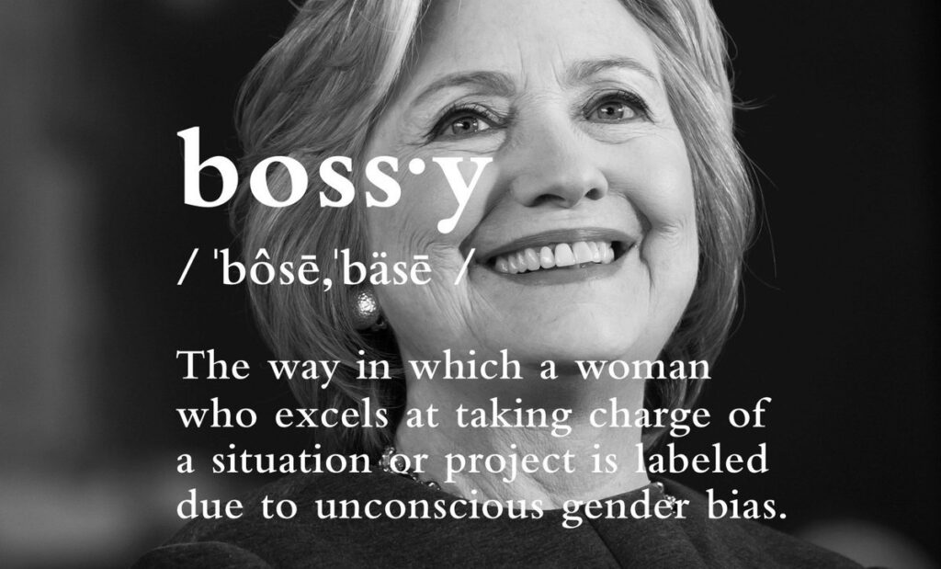
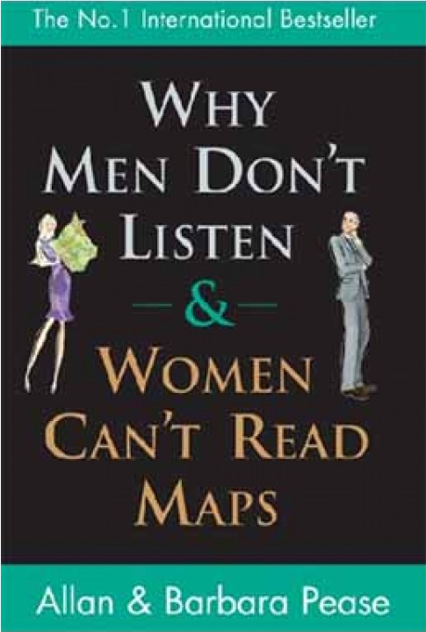
Studying Gender
Do men and women use language differently?
Is language historically sexist?
Is the language of women inferior?
Sociolinguistics
To what extent is gender a socially constructed idea and how do people ‘perform’ gender through language?
‘Nice girls don’t swear’
Is it more acceptable for men to use taboo language?
Notes:
Connecting elements of current learning to future potential interests: power play between Lady Macbeth and Macbeth in discourse: the dynamics of their exchange during the evening they are hosting Duncan; the paradoxical language choices of the speaker in i wanna be yours and its implications about gender, or love semantic fields of power, and materialism - why does the latter reference such a wide contextual range: 50s to 80s, and what has it got to do with love?

Slide 8
How did you do?
Statements | T | F
In all conversations there will be a dominant speaker and someone who is less powerful. ( Fairclough, 1989 – Unequal Encounters)
The lower down a social class a person is, the less likely they are to pronounce ‘g’ at the end of words. (Trudgill, 1983)
Men’s talk focuses on activities rather than feelings.
Women use more tag questions.
Women are happier long pauses in conversation than men.
Men use more insults in conversation. (Pilkington, 1992)
Women are more likely to drop the ‘g’ in words.
Women are more status-conscious than man.
Men use ‘you know’ 5 times more than women. (Fishman, 1980)
Women use ‘I think’ more than men. (Coates, 1996)
Men interrupt more than women.
Men are more likely to interrupt other men than women. (Zimmerman and West, 1975)
Statements | T | F
In all conversations there will be a dominant speaker and someone who is less powerful. ( Fairclough, 1989 – Unequal Encounters) | √
The lower down a social class a person is, the less likely they are to pronounce ‘g’ at the end of words. (Trudgill, 1983) | √
Men’s talk focuses on activities rather than feelings. | √
Women use more tag questions. | √
Women are happier long pauses in conversation than men. |  | √
Men use more insults in conversation. (Pilkington, 1992) | √
Women are more likely to drop the ‘g’ in words. |  | √
Women are more status-conscious than man. | √
Men use ‘you know’ 5 times more than women. (Fishman, 1980) | √
Women use ‘I think’ more than men. (Coates, 1996) | √
Men interrupt more than women. | √
Men are more likely to interrupt other men than women. (Zimmerman and West, 1975) |  | √
Decide whether you think research on language found these things to be true or false!
Notes:
Automated heading – have the feedback discussion on the true/false - First click brings up answers

Slide 9
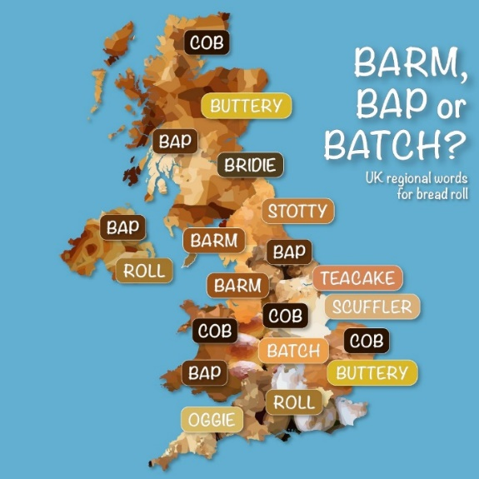
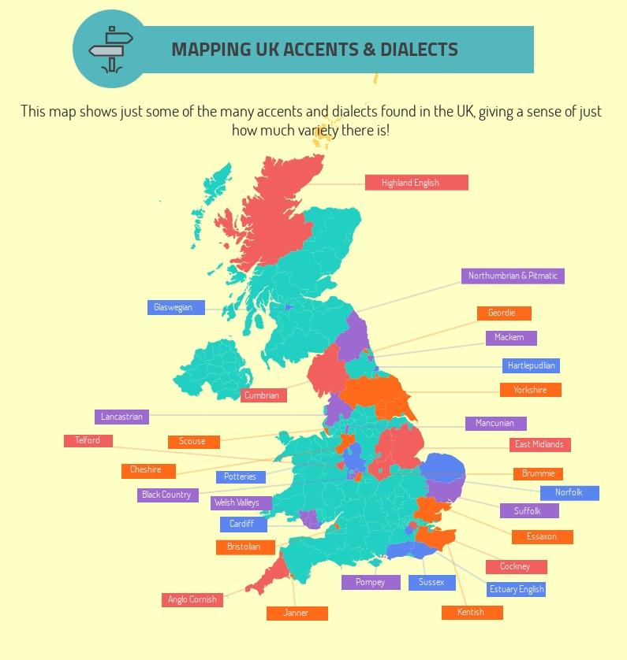
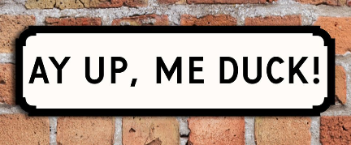
Regional diversity
Regional dialectology: The identification and mapping of the boundaries between different varieties on the basis of clusters of similar and different features in particular regions, towns or villages
Interspeaker variation: Differences and variation that is measured between different speakers
Stereotypes
Social identity theory
Sociolinguistics
How do speakers’ accents and dialects reflect identity and attitudes?
Style-shifting
Social class
Speech community
Exploring studies
For example, Martha’s Vineyard: A study of social dialects
Social dialectology: The study of linguistic variation in relation to speakers’ participation or membership in social groups
Notes:
Cob debate… Birling “provincial”: represented as a pompous Northerner. Priestley’s marking of his otherness, in terms of the Upper Classes also perhaps unintentionally reinforcing something else to his 1945 audience – when the King/later, Queen’s English was still the gold standard

Slide 10
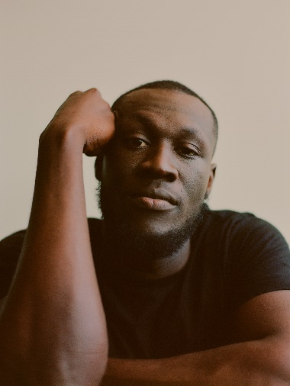
Studying Identity
Ethnicity
How does ethnicity influence language use?
Age
Big up MLE - the origins of London’s 21st century slang
Sociolinguistics
Is slang sabotaging language?
Teenspeak is not for adults
Why do people borrow features of another ethnic group’s language?
The rise of Multicultural London English, innit? | SOAS Blog
Notes:
The language of Sheila and Eric cf to their parents; choice of non-fiction texts to practise Paper 2 skills; currency

Slide 11
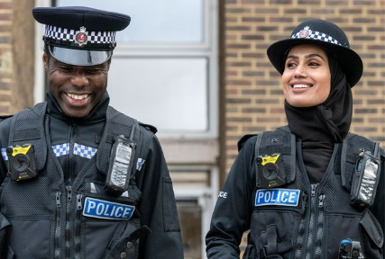
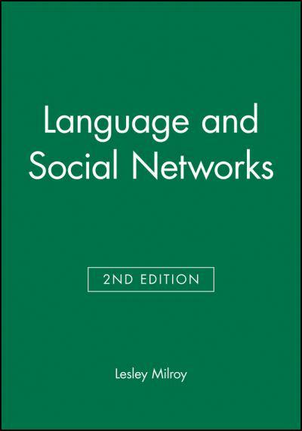
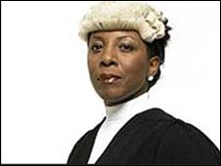
Studying the influence of social groups
Occupation
Social networks
Sociolinguistics
Notes:
The Birlings, the way their language choices around duty, money (and golf) reflect a tight knit community of self-interest; the non-standard language choices of modern poets – anthology or unseen; the register of non-fiction texts and their implied audience;

Slide 12
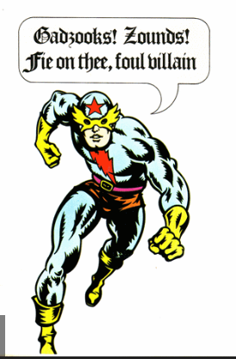
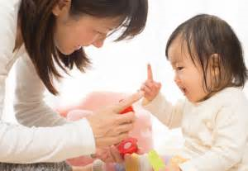
In Y13, Studying Child Language Acquisition and Language Change
Child Language Acquisition
Language Change
‘Covidiot’
How do children go from non-verbal to speaking sentences?
Why does Shakespeare’s language seem so different to ours?
How did ‘chugging’ (charity mugging) come to be a word?
What is more important: nature or nurture?
Why do we have words with silent letters? Scent, debt, fasten, hide …
How do children learn language so fast?
Why does the English Language have so many words for the same thing?
In 2013, the Oxford English Dictionary identified ‘selfie’ as the most popular new word.
Notes:
Some of this very specific to the A level – but Shakespeare is a natural context for some of the debates that can be had around etymology or the coinage of new words - neologisms, or contribution of idiom to the richness of language for example communicator? But encouraging a curiosity and interest in the way language is changing in the here and now as an ongoing thread in your teaching – how this unites and divides, how it marks changing attitudes and contexts – improve critical thinking skills as well as encourage an interest in language itself that might bring students to the doors of the A level

Slide 13
Child Language Acquisition
Applying knowledge of language levels to contexts of use
Look at these two pieces of research, and then look at the data – a set of first words – to see if you can work out whether it supports the research or not
Concepts and Issues:
Katherine Nelson: around 60% of children’s first words are nouns
HINT: noun = the name of something, like a spoon. An abstract word would be a concept rather than the word for a concrete thing, like ‘love’.
Oh – and you might have to do some maths!
Jasper hello no poo woof toast
socks hiya yes book please Marmite
Daddy yeah duck bot-bot jam shoes
ta my ball bowl hot quack quack
juice cuddle wassat jump eyes bye-bye
cup mummy biscuits bubbles nice more spoon bang cat Laa-Laa
40 (4 removed for ease of analysis: Nana, Grandad, weeble, two)
Data set: First Words
Concepts and Issues:
Piaget: children cannot produce more abstract language until their brains have developed the capacity for more abstract thoughts
22 out of 40 are nouns – 55% - more or less in line with the research! Bang, more and nice might be considered more abstract – but it is easy to imagine situations that make the meanings of these words accessible to a young child!
Notes:
Importance of understanding research contexts for language observation – particularly in the investigation in Year 12-13. Briefly discuss the two research contexts for each of the depicted investigations.
Data set 1: Paint. This palette of colour is used to test Lakoff’s theory. How would you design a task – with the palette - that could do this? Women talk more – more words? Longer noun phrases for colours? Different lexicon – variations on blue/red – more specific colour language for women? Do men take more of an interest in their wardrobe these days? Might that affect the findings?
Words they looked at earlier were– as they guessed - taken from real data of a child’s first words- some students may have seen these patterns in their group discussion already. Rachel’s first words: data set 2. Are Nelson’s findings supported? (highlighted are nouns) Given Piaget’s theory – how would you explain HOW the data supports it? 23 or 24 out of 40 are nouns (poo?) – roughly 60%; all are concrete, for naming things – makes sense – vocabulary building is very prominent in the early stages of language acquisition; re. Piaget: very few abstract meanings – hot; nice; others are needs-related and social.

Slide 14
You will be assessed on the following skills:
Assessment Objective | Description
AO1 | Your knowledge of and ability to use linguistic terminology; and accuracy and effectiveness of your written expression
AO2 | Your knowledge of ideas and issues around language use, and of relevant research
AO3 | Your ability to consider the influences of contexts of production (the intention and purpose) and reception (how the audience respond)
AO4 | Your ability to compare texts
AO5 | Your creativity and expertise in the use of language as a writer to a publishable standard
*You will be learning through exemplars, reflective peer and individual marking, cyclical review of targets and achievement, redrafting.

Slide 15
Isn’t Language fascinating?! If you think you might be interested in exploring the role that language plays in expressing, and shaping our individual and our public identities – please consider joining us. Finally, take the quiz that follows – some language trivia that you might – or might not be aware of!

Slide 16
1. Roughly what proportion of the world's population is fluent or competent in English?
(a) one person in 1,000
(b) one in a 100
(c) one in 10
(d) one in four
1. (d) According to David Crystal in "English as a Global Language" (2003), "[A]bout a quarter of the world's population is already fluent or competent in English, and this figure is steadily growing—in the early 2000s that means around 1.5 billion people."
Out of the world's approximately 7.8 billion inhabitants, 1.35 billion speak English. The majority aren't native English speakers, however. About 360 million people speak English as their first language. – 20%. 10 Mar 2021

Slide 17
2. Which country contains the largest English-speaking population in the world?
(a) England
(b) United States
(c) China
(d) India
(e) Australia
2. (d) English is spoken by upwards of 350 million people in urban areas of India.
India — colonized by the United Kingdom until the mid-20th century — has by far the most speakers, with around 265 million speakers of English. And that’s followed by the Philippines (50 million), Bangladesh (29 million) and Pakistan (25 million).

Slide 18
3. In approximately how many countries does the English language have official or special status?
(a) 10
(b) 15
(c) 35
(d) 50
(e) 75
3. (e) The director of editorial projects for the "Oxford English Dictionary," Penny Silva, says that "English has official or special status in at least 75 countries (with a combined population of two billion people)."

Slide 19
4. Which of the following terms refers to the substitution of a more offensive word or phrase for one considered less offensive?
(a) dysphemism
(b) euphemism
(c) dramatism
(d) orthophemism
(e) neologism
15. (a) See: How to Flatter an Audience With Euphemisms, Dysphemisms, and Distinction.

Slide 20
5. The English language is conventionally divided into three historical periods. In which of these periods did William Shakespeare write his plays?
(a) Old English
(b) Middle English
(c) Modern English
6. (c) The period of Modern English extends from the 1500s to the present day. Shakespeare wrote his plays between 1590 and 1613.

Slide 21
6. Which of the following is the longest word that appears in a play by William Shakespeare?
(a) honorificabilitudinitatibus
(b) sesquipedalian
(c) antidisestablishmentarianism
(d) disproportionableness
(e) incomprehensibleness
7. (a) Honorificabilitudinitatibus (27 letters) shows up in a speech by Costard in Shakespeare's comedy, "Love's Labour's Lost." "O, they have liv'd long on the almsbasket of words. I marvel thy master hath not eaten thee for a word, for thou art not so long by the head as honorificabilitudinitatibus. Thou art easier swallowed than a flap-dragon."

Slide 22
7. How many words did Shakespeare invent?
(a) 496
(b) 999
(c) 1700
(d) 2100
(e) 54
Shakespeare did not create nonce words. He took an entirely different approach. When he invented words, he did it by working with existing words and altering them in new ways.

